Slide 1
Capstone Project - The Battle of Neighborhoods
By Mohsen-AM

Slide 2
Introduction
New Delhi is the capital city of India. It is a part of the city of Delhi’s 11 districts. The city itself has a population of 257,803. However, the much larger metro area has a population that exceeds 26 million.
New Delhi are used interchangeably to refer to the National Capital Territory of Delhi (NCT), these are two distinct entities, with New Delhi forming a small part of Delhi. The National Capital Region is a much larger entity comprising the entire NCT along with adjoining districts in neighboring states.
The official language of New Delhi and the one that is most widely spoken is Hindi. However, English is also spoken as a formal language within businesses and government agencies. Over last decades it is continuously grow because of the city’s important role in government and commercial business.
With its diverse culture, comes diverse food items. There are many restaurants in New Delhi City, each belonging to different categories like Chinese, Italian, and French etc. So as part of this project, we will list and visualize all major parts of New Delhi City.
Questions that can be asked using the above mentioned datasets
What is best location in New Delhi City for Chinese Cuisine?
Which areas have large number of Chinese Restaurant Market?
Which all areas have less number of restaurant?
Which is the best place to stay if I prefer Chinese Cuisine?
What places are have best restaurant in New Delhi?
Most of people who visit New Delhi has this common questions in their minds so, in this project with help of the data I will be able to answer most of the recommended questions and this will appear in details in my notebook submission in week5 of the Capstone Project.

Slide 3
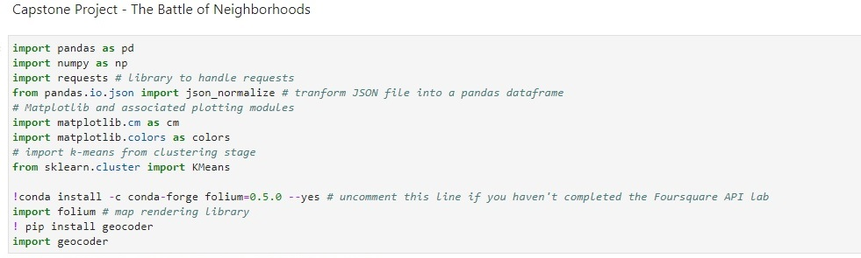
Importing libraries

Slide 4
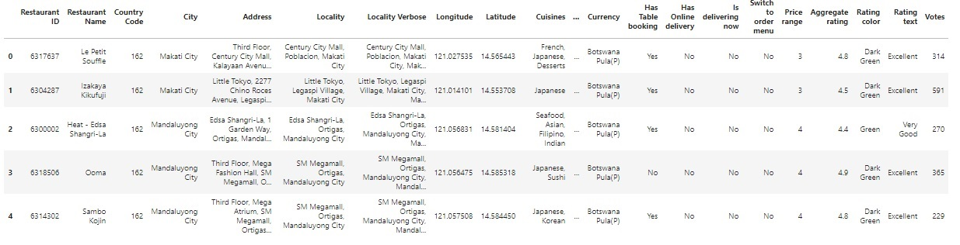
Reading Data from .CSV file from the hosted website

Slide 5
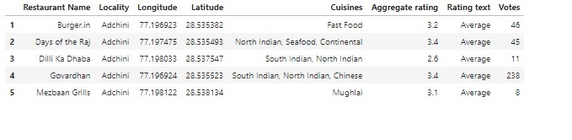
Data Cleaning

Slide 6
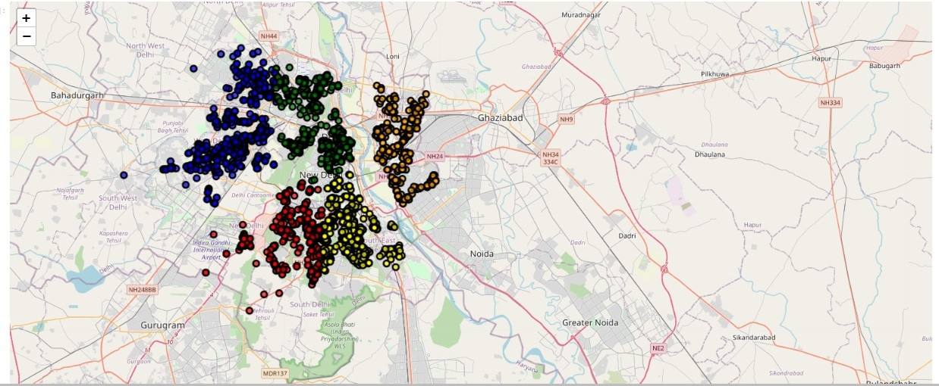
Creating Map to show the resturarnt Clustring

Slide 7
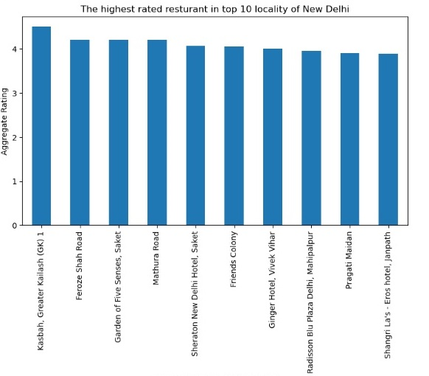
Using matplotlip to visualize and analyze data

Slide 8
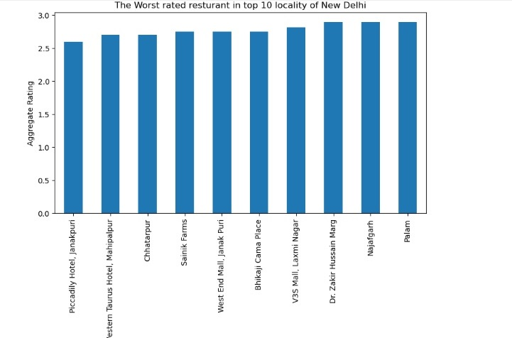
Matplotlip plotting

Slide 9
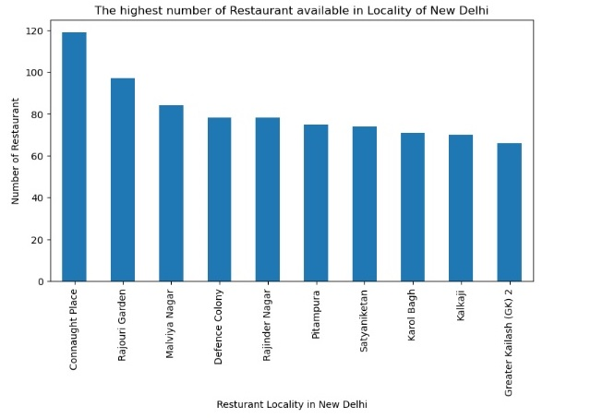
The highest number of restaurant present

Slide 10
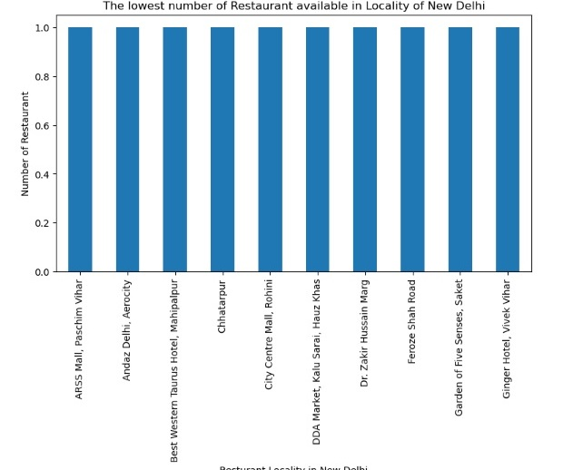
The lowest number of resturants areas

Slide 11
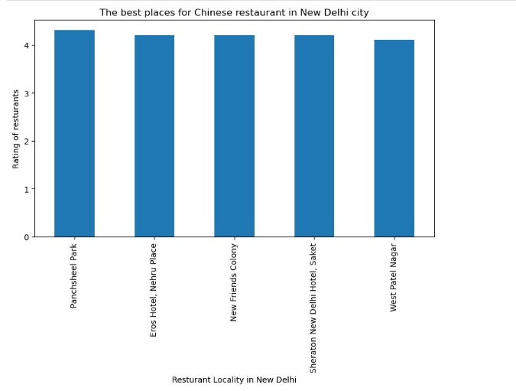
The best places for Chinese restaurant in New Delhi city

Slide 12
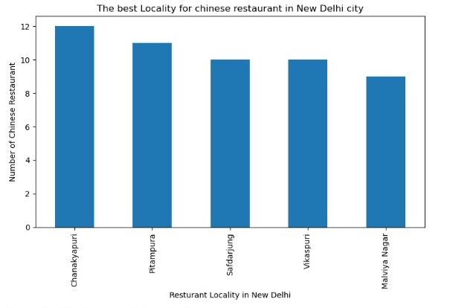
The best Locality for chinese restaurant in New Delhi city

Slide 13
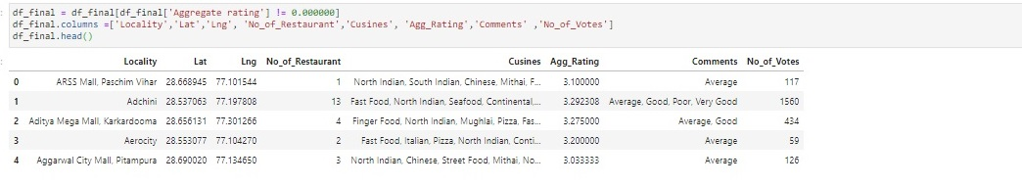
Data Transformation

Slide 14
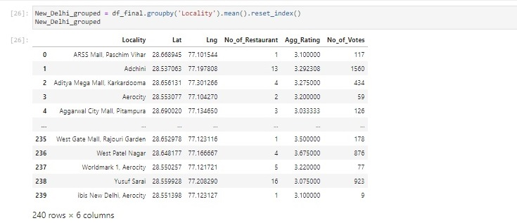
Define Foursquare API Data

Slide 15
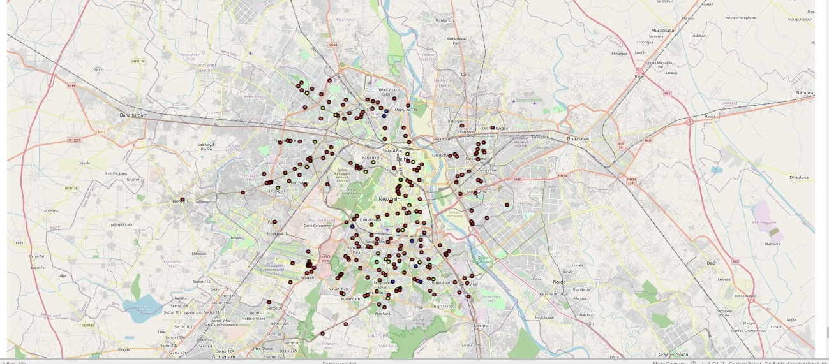
Creating Map after Foursquare API definition

Slide 16
Thanks for Watching my presentation All the best for you

